Slide 1
OSCAT
Open Source Community for Automation
Technology
Presentation
Jan 2011

Slide 2
What is OSCAT
Library for IEC61131-3
Hardware independent
Open Source
License free
Distributed development community

Slide 3
OSCAT Mission
OSCAT Creates open source libraries for IEC61131-3 for all basic needs.
OSCAT focuses on portability and standardization among the great variety of PLC hardware platforms.
OSCAT shares its IP among all PLC programmers and greatly benefits from the experience and input of it's users.

Slide 4
OSCAT History
Aug. 2006 Library 1.0 for Codesys 2.3
Feb. 2007 Library 1.4 for STEP7
Jan. 2008 Library for PC Worx Multiprog
Apr. 2008 added Support for Codesys 3.0
Nov. 2009 release of OSCAT Network Lib 1.0
Jan. 2011 Network Lib supports Beckhoff
Current version: Basic 3.21 & Network 1.10

Slide 5
Available Libraries
 | Codesys 2.3 | Codesys 3.0 | Step 7 | PCWorx
OSCAT BASIC | 3.21 | 3.21 | 3.20 | 3.21
OSCAT Network | 1.10 |  |  | 1.10
OSCAT Building | Q1 / 2011 | Q1 / 2011 |  | Q1 / 2011
OSCAT File System

Slide 6
Open Source Library
Easy transfer between different systems
100% open source code
Tested on multiple Hardware platforms
Tested in various applications
Highly optimized code for best performance
Continuous maintenance
frequent releases and updates
detailed revision and release history
revision tracking on module level

Slide 7
IEC61131-3 Standard ?
Different programming languages
Basic programming statements
Manufacturer specific libraries
  No Source Code, Debugging complicated
  No Standard for complex modules
  Modules can't be adopted or changed
Hardware change is tough because libraries are bound to Hardware
Various implementations of standard
  Different CPU's behave differently
  MOD, TRUNC, ....
  Date and Time is not Standard
  MUX, MIN, MAX, ....

Slide 8
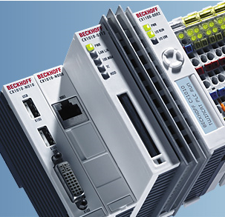
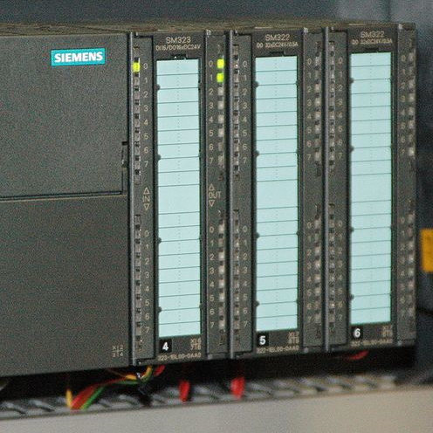
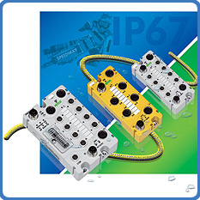
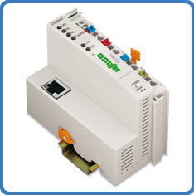
before OSCAT
APP 1
APP 2
APP 3
APP 4
Lib 1
Lib 2
Lib 3
Lib 4

Slide 9
with OSCAT
Independent APPLICATION
OSCAT Library

Slide 10
OSCAT Structure
Application
Building
…..
Network
File
???
BASIC
OSCAT
Hardware

Slide 11
OSCAT advantages
Independent of Development Tools
  Codesys 2
  Codesys 3
  PCWorx
  Step7
  More to come
Independent of Hardware
Open Source for Debugging
Change and create your own

Slide 12
Cross Platform availability
Codesys 2
Codesys 3
Multiprog / PC-Worx
STEP7
Text format for easy import in other systems
Based on IEC61131-3 functions
Hardware tested on multiple Platforms / CPUs
Further Platforms in preparation

Slide 13
OSCAT Platform Usage
Data from OSCAT user Forum December 2008
OSCAT is used on the following platforms
Codesys 2.3 43%
Twincat 19%
Step 7 19%
Codesys 3.0 6%
PCWorx/MProg 6%
Andere 8%

Slide 14
OSCAT Hardware Usage
Data from OSCAT user Forum December 2008
OSCAT is used with the following Hardware
Wago 29%
Beckhoff 22%
Siemens 19%
Moeller 9%
Micro Innovation 6%
Andere 15%

Slide 15
Testing and Verification
Development on different systems assures independence of code
Runtime tests on different hardware systems
Testing with random patterns
Test of math functions to 6 digits resolution
Test program for all functions
Projects verify the library on different systems
Verification under different development systems
OSCAT works together with most other libraries

Slide 16
Most complete Library
The OSCAT Library keeps growing
Continuous improvement of code
Inputs from many users and applications
Open source guarantees flexibility
OSCAT is optimized for 32 bit non FPU CPUs
Extraordinary performance also on 16Bit CPUs

Slide 17
OSCAT components
Over 800 Library Modules available
Mathematics
Time/Date
String / List / Buffer
Networking
Automation / Control
Networking
..........

Slide 18
Buffer Management [7]
Modules to handle large arrays of Byte
Initialization and clear
_BUFFER_INIT, _BUFFER_CLEAR
Insert and retrieve from Buffer
_BUFFER_INSERT, _STRING_TO_BUFFER, BUFFER_TO_STRING
Searching
BUFFER_SEARCH

Slide 19
List Management [9]
Modules to handle lists
Lists are multiple elements separated by a separation character stored in STRING(255)
Insert and retrieve from list
Evaluate length of list LIST_LEN
Clean list from empty elements

Slide 20
Building Automation [47]
Actuators for Valves, Flaps, Pumps...
Electrical, Switches, Dimmers, Timers...
HVAC
Blind Control

Slide 21
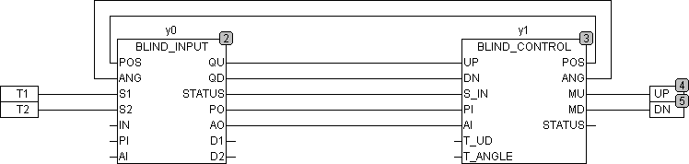
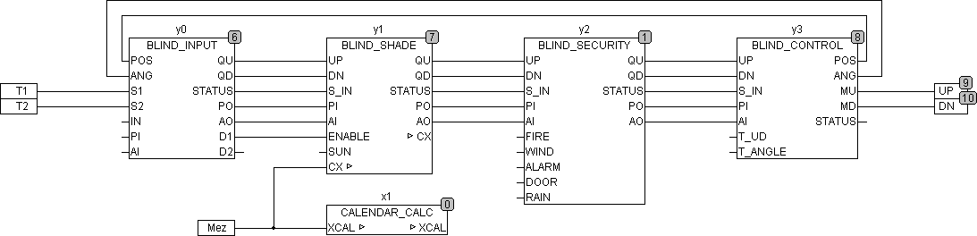
Blind Control Example

Slide 22
Device Drivers [4]
Interfaces to Standard Devices
IRTRANS Infrared Transceivers over TCP/IP
Decoder for DCF77 receiver

Slide 23
Automation [27]
Incremental decoder with quad resolution
Profile generation
Drivers
Signal generators
Interlock
Tuning
.....

Slide 24
Control [34]
Basic building blocks
Integrator, Differentiator, LT1, LT2, Delay...
Advanced building blocks FT_PI, FT_PDT1 ...
Anti Wind-Up circuitry
Modular controller design and building blocks
Regulators PID, PI, Hysteretic ....
Control set calculation for PI and PID
Signal Filters

Slide 25
Conversion [30]
Converting between different Units:
Temperature
Pressure
Length
Speed
Compass directions
Wind Speeds
.....

Slide 26
Measurement [12]
Calibrate, Offset, Scale
Bar graph Lin or Log
Cycle time, ontime
Time and Pulse measurement
Ontime with 64 Bit resolution
Consumption Meter and Statistics

Slide 27
System Time Base [5]
T_PLC_MS() and T_PLC_US()
Standard interface for reading the system timer
Millisecond and microsecond resolution
Debug functions for overflow
Debug functions for speed increase to test slow processes.
TC_MS, TC_US, TC_S returns cycle time in
microseconds, milliseconds or seconds

Slide 28
Sensor Interface [10]
PT, NI, SI, NTC Sensor formulas
Calculate temperature from resistance
Calculate resistance from temperature
Scale and offset calibration
Compensation for parasitic resistors
Redundant Analog or Digital sensor interfaces

Slide 29
Signal Generators [15]
Standard functions
SIN, triangle, ramp, square wave
Adjustable offset, delay and amplitude
Pulse and Bitmap generators
Modulated generators, PWM
Controlled Ramp Functions
Random time and pulse generators
Time and Logic Sequencers

Slide 30
Signal Processing [42]
Transfer functions for analog signals
Input and output adjustments for A/D and D/A
Sample and hold circuits
Multiplexing and Fading
Signal Delay
Offset, Override and Mixing Functions
Scaling for byte and boolean inputs
Staircase functions

Slide 31
Boolean Logic [81]
Flip flops, latches and shift registers
Edge and ramp triggered logic
CRC and parity functions
Matrix keyboard scanner
Stack and fifo memory
TP_R Pulse generator retriggerable
B_TRIG, DTRIG Trigger any edge or DWORD
Programmable pulse generators or sequencers
Conversion BCD, DWORD, BYTE, HEX

Slide 32
Networking [11]
Support for TCP/IP and UDP
Basic functions for protocol stacks and communication
SNTP simple network time protocol
IPv4 address decoder
DNS resolution
HTML coding and decoding
XML parsing
Yahoo weather
......

Slide 33
ESR [4]
Error and Status Reporting
Standardized interface to OSCAT building blocks for data logging, debugging and status reporting
Event monitoring
Collection of data and status of the process
Time stamp and address label
Interface to servers via TCP/IP
Data and activity logging over TCP/IP

Slide 34
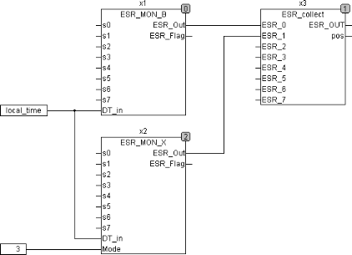
ESR example

Slide 35
Mathematics [144]
Extensive mathematical functions
over 100 mathematical functions
Functions for complex numbers
Functions for vector analysis
Linear and polynom interpolation
Geometry functions
Array handling
Statistical functions
Double precision mathematics

Slide 36
STRING [76]
Extensive string functions
over 60 string functions
Conversion functions
Uppercase and Lowercase
Support for extended ASCII > 127 (Ä,Ö,Ü)
Enhanced FIND and Replace
Trim functions
String length up to 255 characters
....

Slide 37
TIME & DATE [51]
Extensive Time and Date functions
RTC Blocks with millisecond resolution
DCF77 receiver and decoder
Date functions with adaption for STEP7
Sun position, sun rise and sun set calculations
Easter and holiday calculations
Complete set of Date and Time calculations
Structured time format and functions

Slide 38
Planned activities
Object oriented library
Library for File Access
Continuous improvement of performance
Continuous maintenance and service releases
Data logging over TCP/IP functions with JAVA code for Servers

Slide 39
License
OSCAT is free of charge
  Private use
  commercial usage
No License agreement necessary
Application Code does not have to be opened

Slide 40
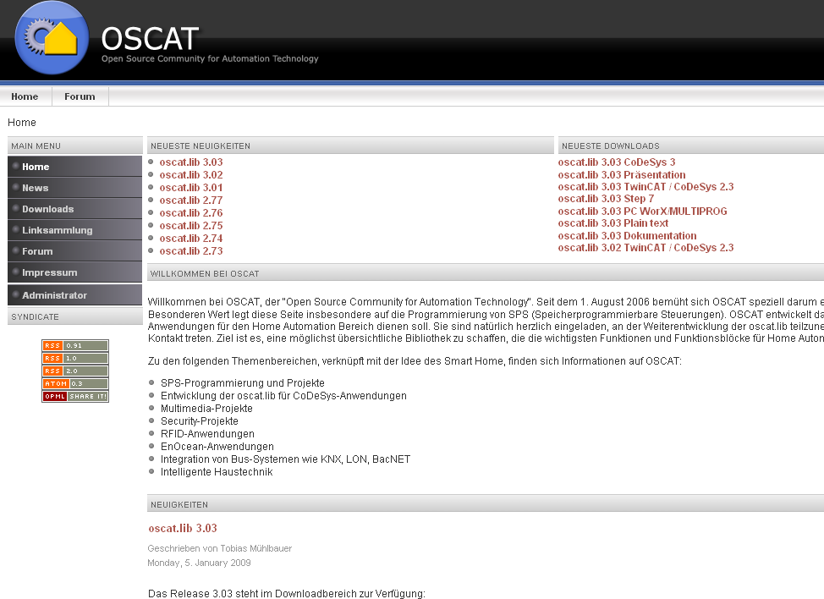
WWW.OSCAT.DE

Slide 41
Downloads
OSCAT.LIB CoDeSys 2.3 / Twincat
OSCAT.LIBRARY Codesys 3.4
OSCAT S7.ZIP STEP7
OSCAT PCW.ZIP PCWorx / Multiprog
OSCAT.TXT Plain text
OSCAT.PDF Manual (German)
HISTORY.PDF Revision history

Slide 42
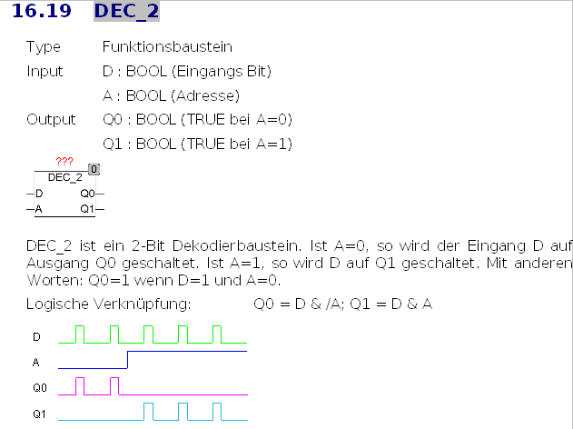
Manual
700 Pages
(German)

Slide 43
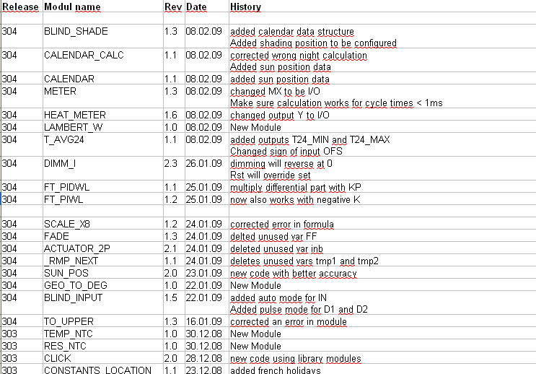
Revision History

Slide 44
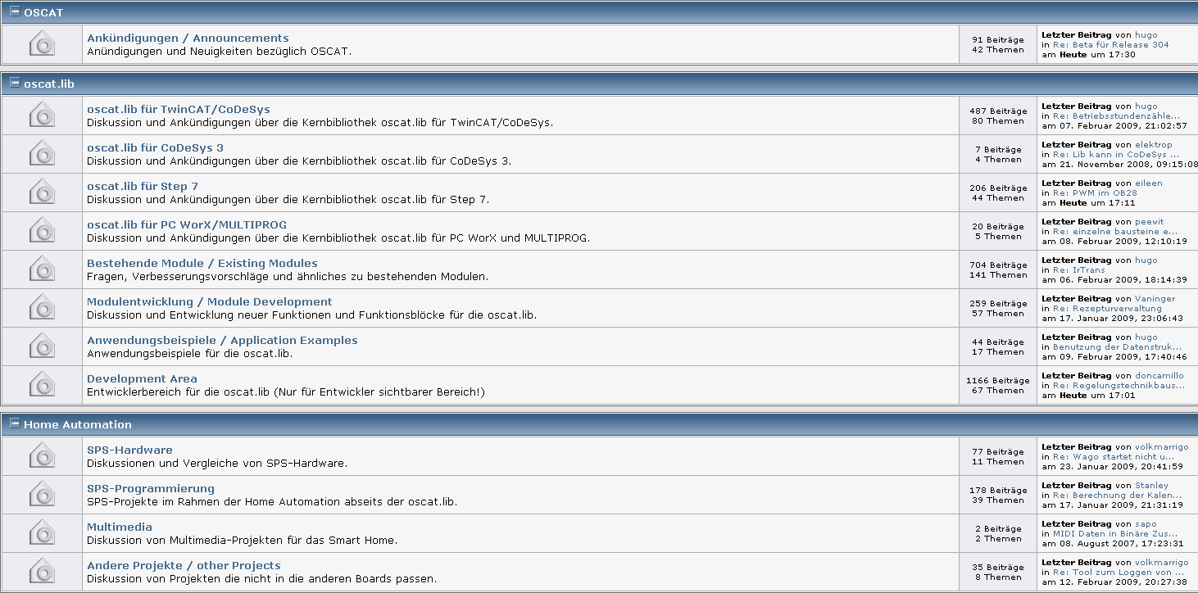
USER FORUM

Slide 45
OSCAT forum page hits
(Quarterly Numbers)

Slide 46
Reference
Wir verwenden die OSCAT-Bibliothek in vielen Bereichen:
Gebäudetechnik (STEP7/Wago/Beckhoff)
Sondermaschinenbau (STEP7)
Automobilbau Klebetechnik (STEP7/Beckhoff)
Die reichhaltige Ausstattung mit Funktionen aus den Bereichen Zeit+Datum, Umrechnungen, String-Funktionen und Regelungstechnik können wir gut einsetzen.
Da wir sehr unterschiedliche Kunden bedienen ist ein weiterer Vorteil die Unabhängigkeit von der verwendeteten Hardwareplattform.
Im Unterricht an der Handwerkskammer für München und Oberbayern bringen wir sie auch ins Spiel.
Weitere Referenzen kann man auf unerser Web-Site www.spssoft.de sehen.
Daniel Bonk
Geschäftsführender Gesellschafter SPS Soft GmbH München

Slide 47
Reference
Wir setzen die OSCAT.LIB im industriellen Umfeld im Bereich der Kühlraumüberwachung und Kälteanlagensteuerung ein.
Weitere Funktionsfelder werden in Zukunft auch mit Hilfe der OCAT.LIB implementiert werden:
Lastausgleich,
Energiemanagement /Max-Abschaltung,
Produktionsanlagenautomatisierung mit Anbindung von Waagen.
Die OSCAT.LIB ist eine besonders gute Hilfe, und da sie ständig fortentwickelt wird, lohnt sich ein Besuch bei OSCAT.DE immer.
Als Einsteiger in die Welt der SPS bin ich sehr dankbar für die nützlichen und offen gelegten Funktionen.
Ich habe schon mehrfach durch den offenen Quellcode Anpassungen vornehmen können, die in anderen geschlossenen Bibliotheken nicht möglich gewesen wären.
Ausserdem kann man sich gute Inspirationen holen, was mit ST alles möglich ist, und wie man es in der Praxis umsetzt.
Vielen Dank an alle Entwickler der OSCAT.LIB für die grossartige (Pionier-)Arbeit!

Slide 48
Reference
wir haben die Bibliothek bis jetzt in einer ABB-AC500 und CoDeSys eingesetzt (Notstromversorgung) In absehbarer Zeit werden auch Teilgebiete der Automatisierung in der Wasserversorgung Straubing von ABB-KT97 auf ABB-AC500 umgerüstet. Mit OSCAT haben wir bis jetzt viel Denk- und Handarbeit erspart, da viele Funktionen schon integriert sind.
Wink Super – weiter so
SW_SR_VFW (Micha)

